Slide 1
Facial Recognition Through Siamese CNNs
Leenane Tinashe Makurumure

Slide 2
Contents
Introduction
Previous Work
Methods
Experimental Work
Results
Discussion And Conclusion
Possible Extensions

Slide 3
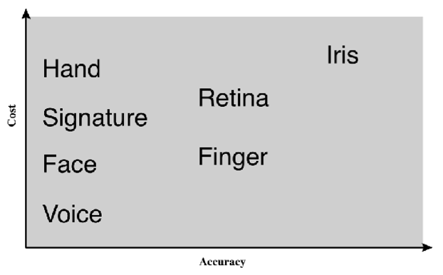
Introduction
Facial Recognition: Cheap but not reliable enough
Conventional strategies: NN and SVM
Working Strategies: Siamese CNNs
Proposed Strategy: Patch-based Siamese CNN

Slide 4
Previous Work
Jane Bromley: Siamese Architecture applied to signature verification
Chopra: Siamese CNN applied to face verification
Khalil: Siamese CNN with fused Convolution and Subsampling layer
CNN variants

Slide 5
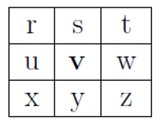
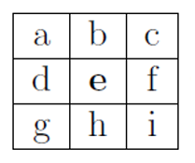
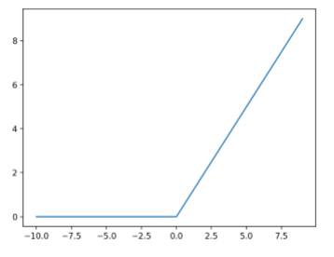
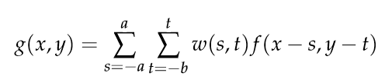

Methods: CNN
Convolutional layer
Consists of filters
Outputs feature maps
Pooling Layer
Scales down feature maps
Max pooling and Average pooling
Activation Function (ReLu)
Fully Connected Layer
A set of 1/more dense layers that leads to the output

Slide 6
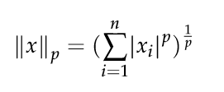
Methods: Siamese CNN
Two Identical networks that share weights
Pair-wise distance
Returns a similarity measure
A genuine pair would have similar feature vectors, a small absolute difference, and a high similarity score. In contrast, an imposter pair would have different feature vectors, a high absolute difference and, a low similarity score.

Slide 7
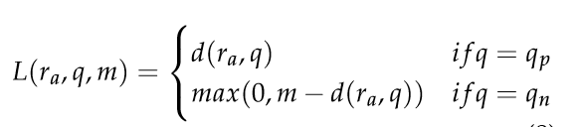
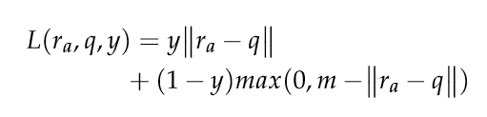
Loss Function
Model error (Expected - Predicted)
Cascaded backwards to update the model weights
Learning stops when optimum weights are found and loss converges to local minimum
Pair-wise ranking loss

Slide 8
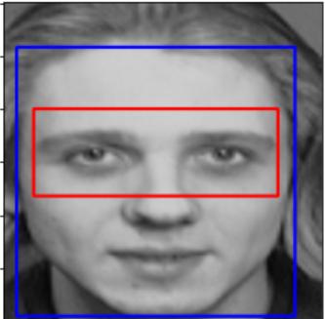
Methods: Haar Cascade Classiﬁer
Patch detection and cascading
Adapted from Viola and Jones in “Rapid Object Detection using a Boosted Cascade of Simple Features”
They introduce: Integral image, AdaBoost, Cascade
Cascade Trainer GUI by Amin Ahmadi

Slide 9
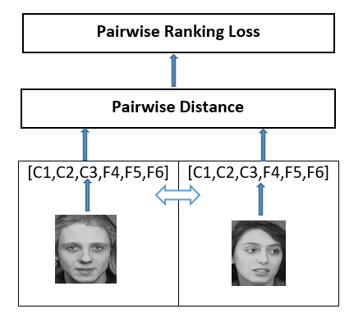
Methods: Model Architecture
C1: Feature maps:5; kernel size 3*3; stride:2; input: 1*100*100 image; output feature maps 5*50*50.
C2: Feature maps:14; kernel size 3*3; stride:2; input: 5*50*50 image; output feature maps 14*25*25.
C3: Feature maps:60; kernel size 3*3; stride:2; input: 14*25*25 image; output feature maps 60*13*13.
F4: input 10140 features; output 3200 features.
F5: input 3200 features; output 1600 features.
F6: input 1600 features; output 40 features.

Slide 10
Experimental Work
Dataset and Pre-processing
Global Siamese CNN
Patch-based Siamese CNN

Slide 11
Dataset
AT&T face dataset.
Initially: 40 people each with 10 images.
Pre-processing: 274 for training and 42 for testing.
37401 pairs for training and 861 for testing.

Slide 12
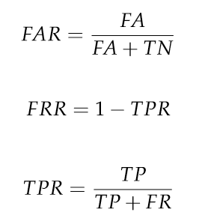
Results
FAR is the likelihood of the model incorrectly accepting an imposter sample
FRR is the likelihood of the model incorrectly rejecting a genuine sample
EER is the value when FAR is equal to FRR (low EER)

Slide 13
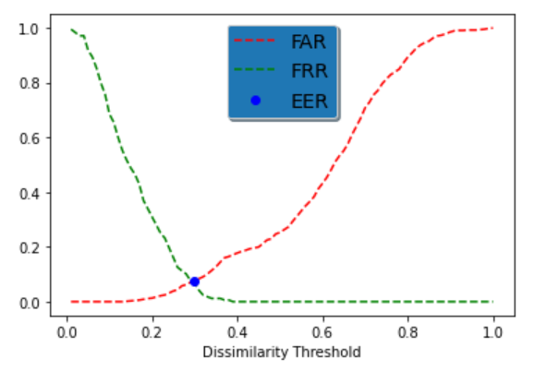
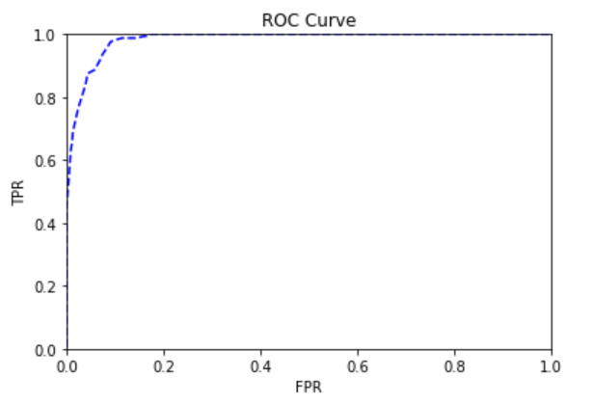
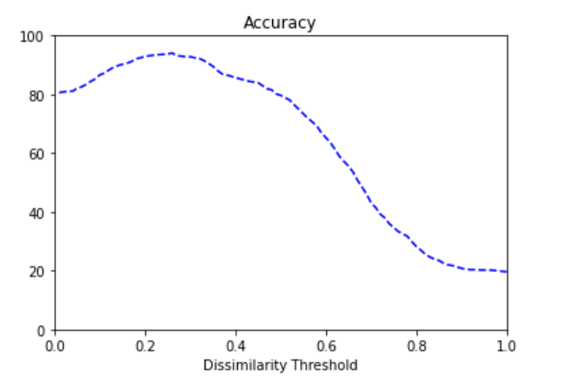
Results: Global Siamese CNN

Slide 14
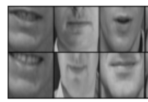
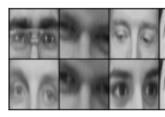
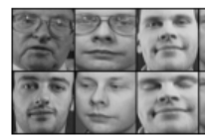
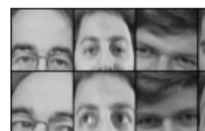
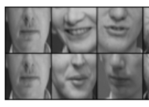
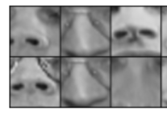
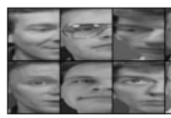
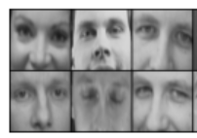
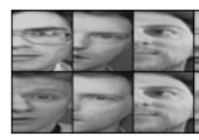
Results: Patch-Speciﬁc CNNs
Patch | EER | Threshold
Patch 1 | 0.247 | 0.29
Patch 2 | 0.30 | 0.32
Patch 3 | 0.29 | 0.36
Patch 4 | 0.074 | 0.23
Patch 5 | 0.173 | 0.37
Patch 6 | 0.063 | 0.29
Patch 7 | 0.167 | 0.34
Patch 8 | 0.079 | 0.23
Patch 9 | 0.166 | 0.35

Slide 15
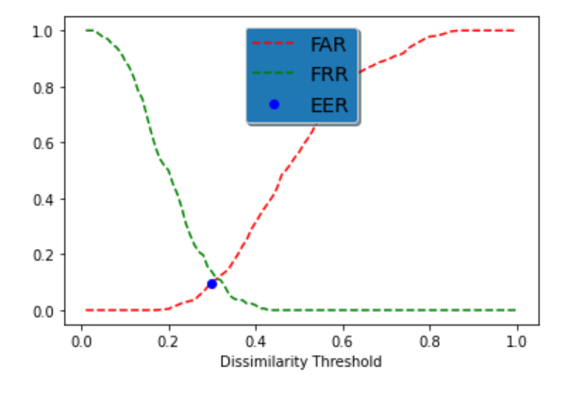
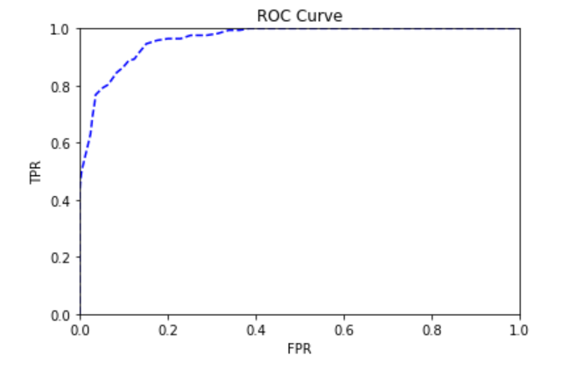
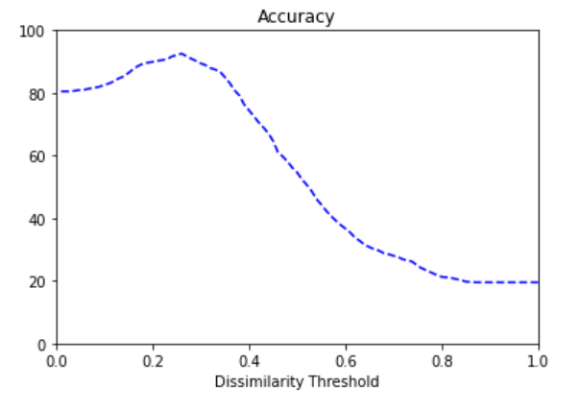
Results: Combination 1

Slide 16
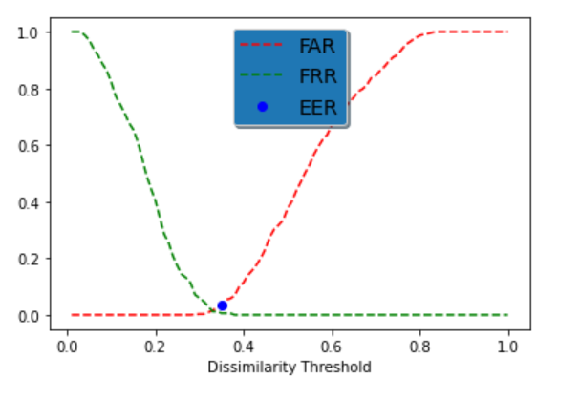
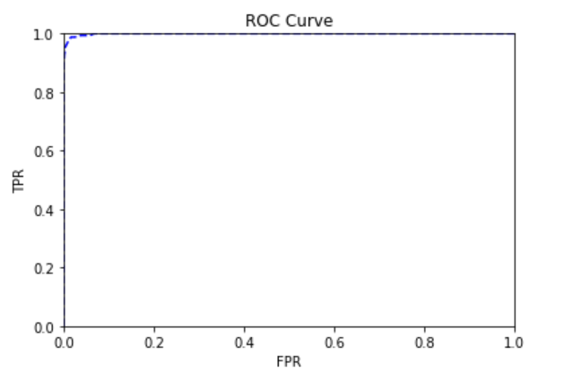
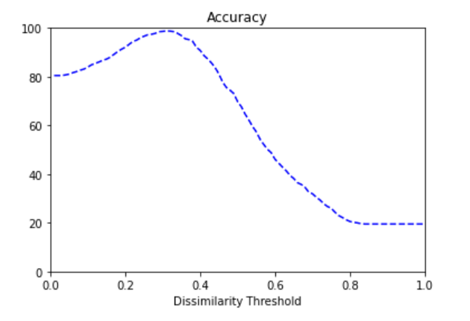
Results: Combination 2

Slide 17
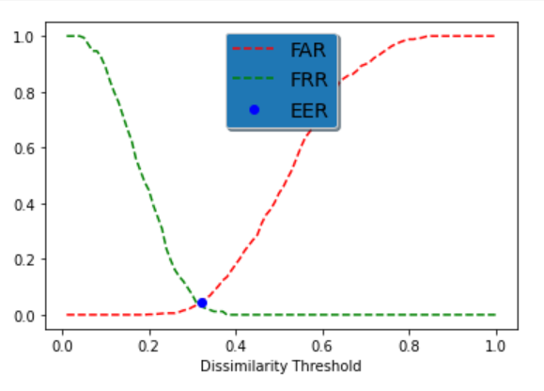
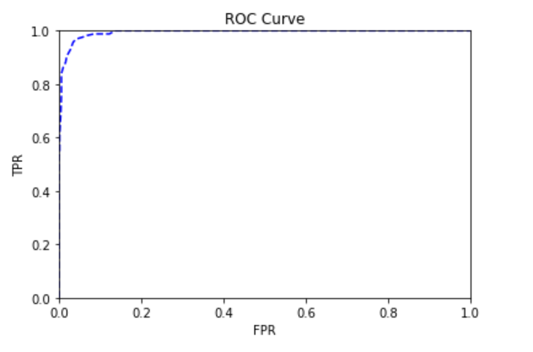
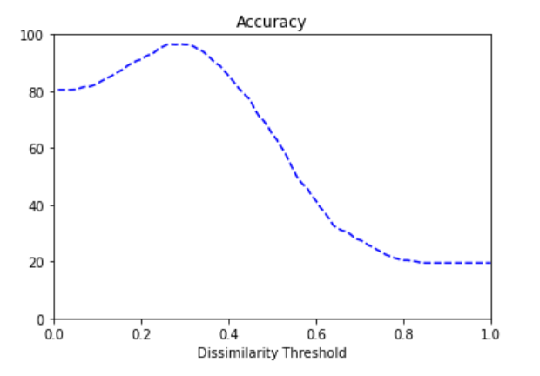
Results: Combination 3

Slide 18
Discussion And Conclusion
New insight: some speciﬁc patches are more effective in accurate facial recognition than others.
More facial information (patches) instead of one global face can achieve better accuracy.
The dissimilarity threshold at the EER position of a Patch-based CNN is more than that of a global CNN.
Correct combination of patches results in better accuracy.
We can use less facial information and maintain accuracy.

Slide 19
Possible Extensions
Explore various detection methods and pre-processing methods.
Adding of methods to dynamically choose and combine patches depending on the situation presented.
Parallel computing.

Slide 20
Thank you

